Slide 1
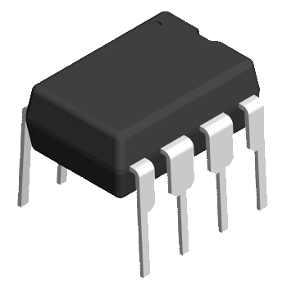
Semiconductor Chips
ASICs
Application Specific
Integrated Circuits
Microprocessors
Microcontrollers
FPGA & CPLD

Slide 2
FPGA Principles
A Field-Programmable Gate Array (FPGA) is an integrated circuit that can be configured by the user to emulate any digital circuit as long as there are enough resources
An FPGA can be seen as an array of Configurable Logic Blocks (CLBs) connected through programmable interconnect (Switch Boxes)

Slide 3
FPGAs Classifications
FPGA types
Implementation Architecture
Logic Implementation
Interconnect Technology
Symmetrical Array
Row based Array
Hierarchial PLD
Sea of Gates
Look Up table
Multiplexer based
PLD Block
NAND Gates
Static Ram
Antifuse
E/EPROM

Slide 4
FPGA Advantages
Very fast custom logic
  massively parallel operation
Faster than microcontrollers and microprocessors
  much faster than DSP engines
More flexible than dedicated chipsets
  allows unlimited product differentiation
More affordable and less risky than ASICs
  no NRE, minimum order size, or inventory risk
Reprogrammable at any time
  in design, in manufacturing, after installation

Slide 5



Manufacturers
Xilinx
Altera
Lattice
Actel
We will work with XILINX FPGAs

Slide 6
.June 2011
The 4 biggest FPGA producers are :
Xilinx 2.4 Billion$ in 2011 49% of US mrket
Altera 40% 1. Billion955
Quick Logic 1% 26 Million$
MicriSemi 4% 207 Million $
Lattice Semi 6% 297 Million
Xilinx and Altera have 89% of the Market
With the top two FPGA companies taking up 89% of the FPGA market, you can be forgiven for thinking there was no one else out there. Xilinx and Altera have done a good job of defending the duopoly but a few companies are gradually winning market share by targeting specific applications

Slide 7
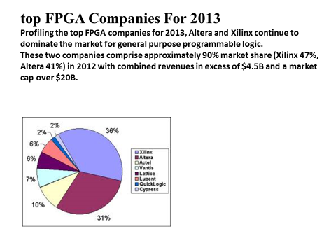

Slide 8
Classes of common commercial FPGA
Symmetrical Array
Row-based
Interconnect
Interconnect
Logic
Block
Logic Block
Hierarchical PLD
Sea-of-Gates
Interconnect
overlayed
on Logic
Blocks
PLD Block
Interconnect
Various Block Architecture & Routing Architecture

Slide 9
FPGAs….[1]
Company | General Architecture | Logic Block Type | Programming Technology
Xilinx | Symmetrical Array | Look-up Table | Static RAM
Actel | Row-based | Multiplexer-Based | Anti-fuse
Altera | Hierarchical-PLD | PLD Block | EPROM
Plessey | Sea-of-Gates | NAND-gate | Static RAM
PLUS | Hierarchical-PLD | PLD Block | EPROM
AMD | Hierarchical-PLD | PLD Block | EEPROM
QuickLogic | Symmetrical Array | Multiplexer-Based | Anti-fuse
Algotronix | Sea-of-gates | Multiplexers & Basic Gate | Static RAM
Concurrent | Sea-of-gates | Multiplexers & Basic Gate | Static RAM
Crosspoint | Row-based | Transistors Pairs & Multiplexers | Anti-fuse
Table 2.2 Summary of Commercially Available FPGAs

Slide 10
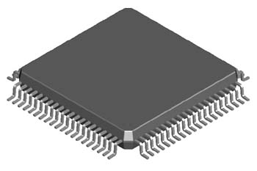
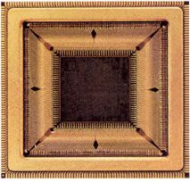
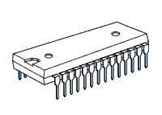
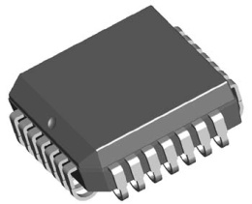
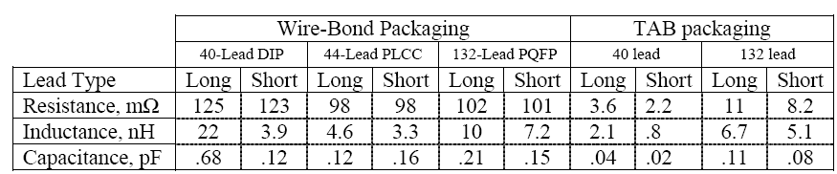
DIP
(Dual In-line Package)
PLCC
(Plastic Leaded Chip Carrier)
PQFP
(Plastic Quad Flat Package)
TAB
(Taped Automated Bonding)

Slide 11
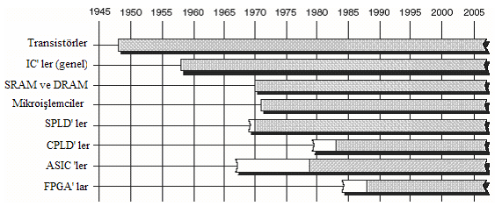

Slide 13
General structure of an FPGA
The Design Warrior’s Guide to FPGAs
Devices, Tools, and Flows. ISBN 0750676043
Copyright © 2004 Mentor Graphics Corp. (www.mentor.com)

Slide 14
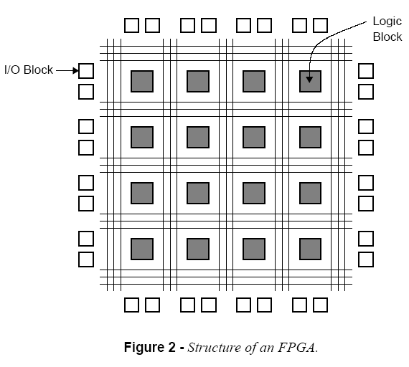

Slide 15
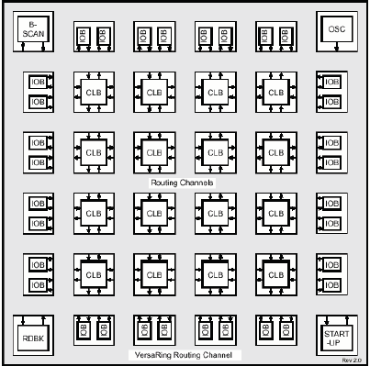

Slide 16
Field-Programmable Gate Arrays
Logic blocks
  to implement combinational
  and sequential logic
Interconnect
  wires to connect inputs and
  outputs to logic blocks
I/O blocks
  special logic blocks at periphery
  of device for external connections
Key questions:
  how to make logic blocks programmable?
  how to connect the wires?
  after the chip has been fabbed

Slide 17
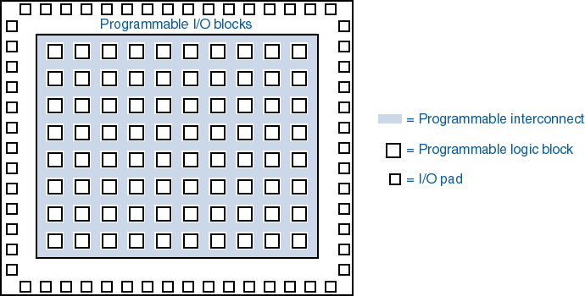
General FPGA chip architecture
a.k.a. CLB --
“configurable logic
block”
Lect #14
Rissacher EE365

Slide 18
Xilinx Spartan 3 FPGAs
The Design Warrior’s Guide to FPGAs
Devices, Tools, and Flows. ISBN 0750676043
Copyright © 2004 Mentor Graphics Corp. (www.mentor.com)

Slide 19
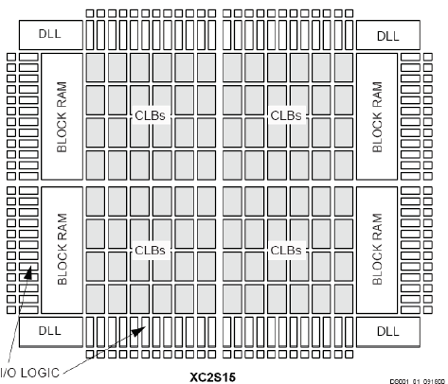
Spartan-II FPGA Family
DLL: Delay Locked Loop

Slide 20
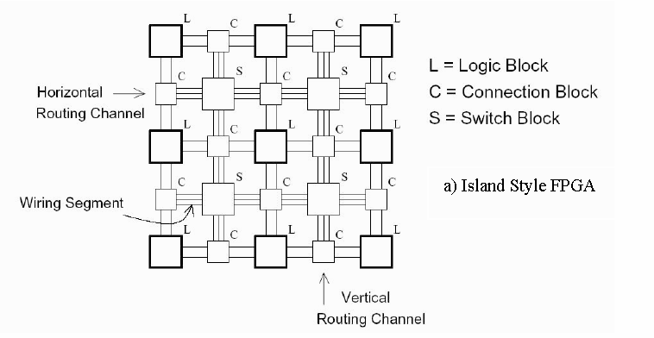
Island Style Architecture

Slide 21
CONCEPTUAL FPGA
Interconnect Resources
Logic Block
I/O Cell

Slide 22
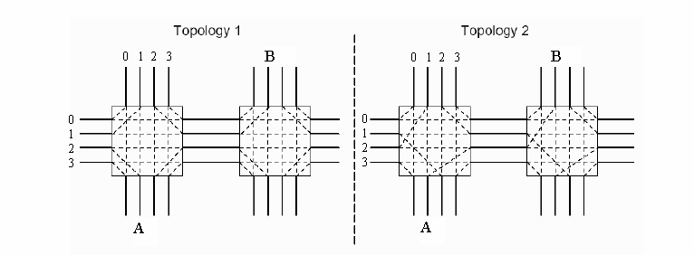
Switch Boxes
Fs, defines for a wiring segment entering the S block the number of other wiring segments it can be connected to
Notes:
The S boxes allow wires to switch between vertical and horizontal wires. Its flexibility, Fs, defines for a wiring segment entering the S block the number of other wiring segments it can be connected to. The topology of the S blocks is very important since it is possible to choose two different topologies with the same flexibility Fs that result in very different routabilities. For example, this figure shows that meanwhile topology 1 can’t connect wire A with B, topology 2 can.

Slide 23
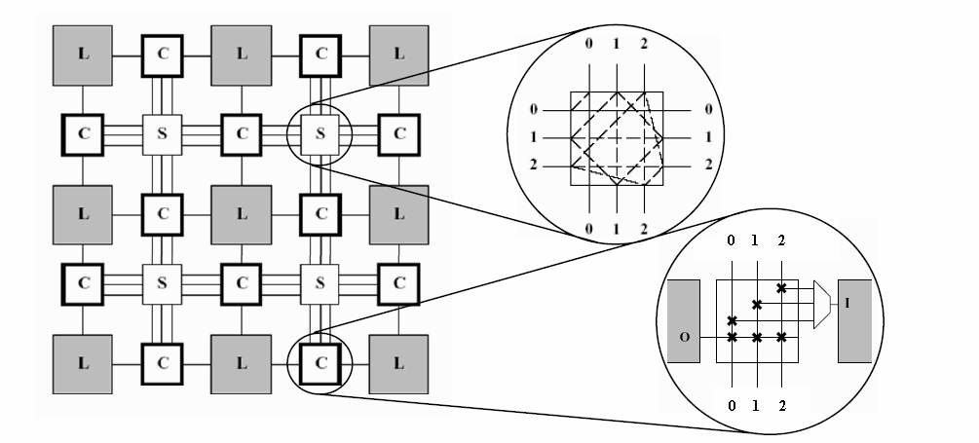
Routings using C and S Boxes

Slide 24
Routing Algorithms
Maze Router
A* Search Routing
The Pathfinder

Slide 27
Xilinx Virtex Architecture
Basic cell of the Virtex FPGA is configurable logic block(CLB)
CLB contains circuitry that allows it to efficiently perform arithmetic
LUT’s can be configured as SRAM cells
Contains programmable input output blocks (IOBs) interconnected to the CLBs

Slide 28
FPGA - Field Programmable Gate Array
S/V block
I/O Cell
S/V block
I/O Cell
S/V block
I/O Cell
S/V
block
I/O
Cell
LB
Logic
Block
LB
Logic
Block
LB
Logic
Block
S/V
block
I/O
Cell
S/V
block
I/O
Cell
LB
Logic
Block
LB
Logic
Block
LB
Logic
Block
S/V
block
I/O
Cell
S/V
block
I/O
Cell
LB
Logic
Block
LB
Logic
Block
LB
Logic
Block
S/V
block
I/O
Cell
S/V block
I/O Cell
S/V block
I/O Cell
S/V block
I/O Cell

Slide 29
The structure of FPGA

Slide 30
Architecture of FPGA-s
Symmetrical
Array
Row-based
LB
LB
LB
LB
LB
LB
LB
LB
LB
LB
LB
LB
LB
LB
LB
LB
LB
LB
LB
LB
LB
LB
LB
LB
Hierarchical (CPLD)
Sea-of-Gates
PLA
PLA
PLA
PLA
PLA
PLA
PLA
PLA

Slide 31
Logical block based on LUT-s
LUT
0
T
MUX
1
S
LUT
0
T
MUX
1
S

Slide 32
Example: realisation of function based on MUX-s.
Y = X1 X2 + X1 X3
X1 = 0
X1 X2 + X1 X3
X1 = 1
X3 = 0
X3
X2
X2 = 1
X3 = 1
X2 = 0
0
1
1
0
0
0
MUX
1
1
S
X3
0
MUX
Y
X3
1
S
1
0
MUX
X2
0
1
X1
S
X2

Slide 33
I/O cells
0
MUX
T
S
1
S/V contact
I/O pad
T
0
MUX
1
S

Slide 34
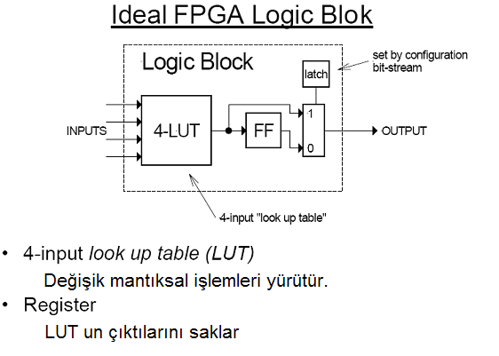

Slide 35
Idealized FPGA Logic Block
4-input look up table (LUT)
  implements combinational logic functions
Register
  optionally stores output of LUT

Slide 36
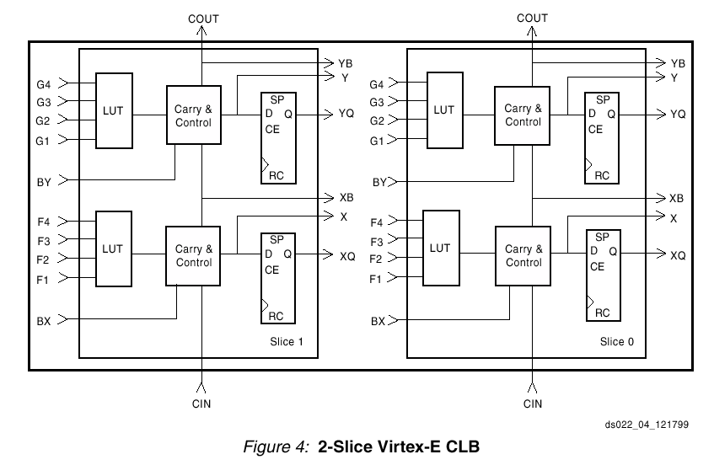
The Virtex CLB

Slide 37
The Virtex CLB

Slide 38
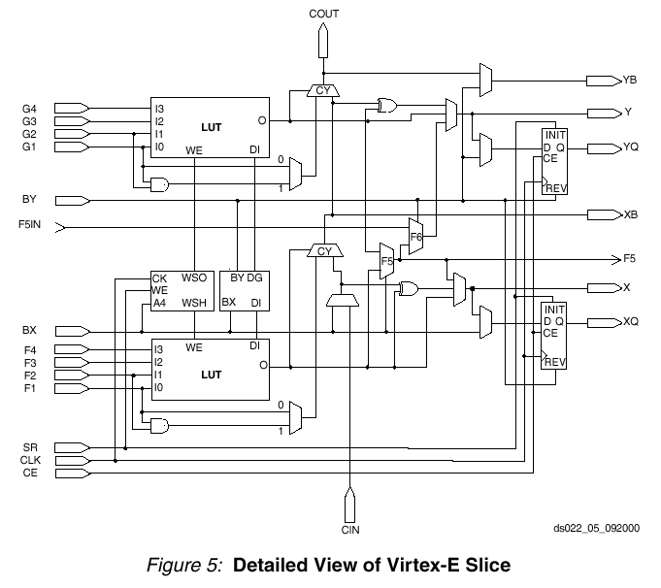
Details of One Virtex Slice

Slide 40
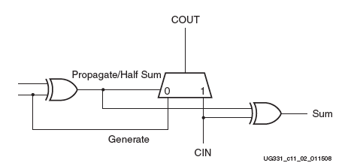
Carry & Control Logic in Xilinx FPGAs
x
y
_{COUT}
0
0
1
1
0
1
0
1
y
y
x
y
_{CIN}
_{CIN}
Propagate = x ⊕ y
Generate = y
Sum= Propagate ⊕ CIN = x ⊕ y ⊕ CIN

Slide 41
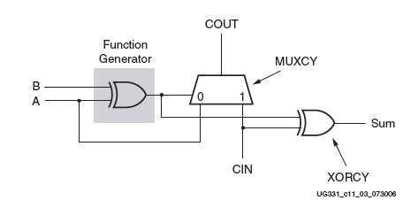
Carry & Control Logic in Spartan 3 FPGAs
LUT
Hardwired (fast) logic

Slide 42
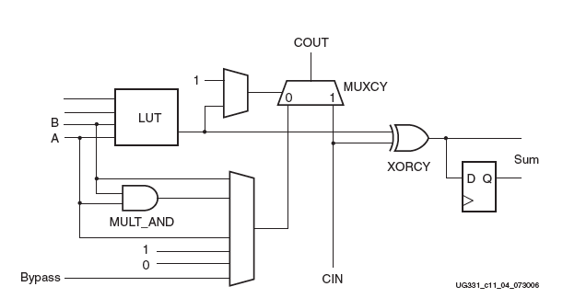
Simplified View of Spartan-3 FPGA
Carry and Arithmetic Logic in One
Logic Cell

Slide 43
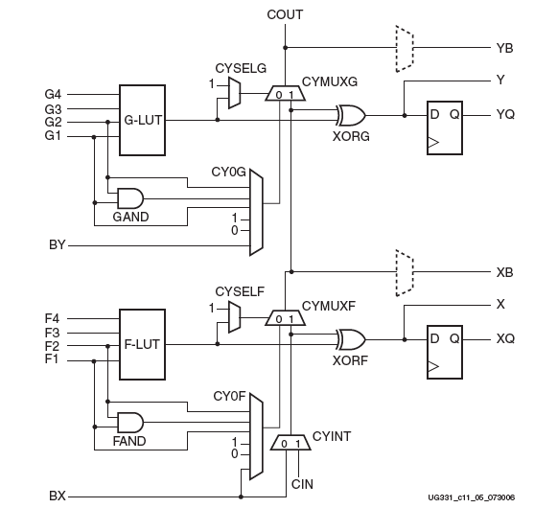
Simplified View of Carry Logic in One Spartan 3 Slice

Slide 44
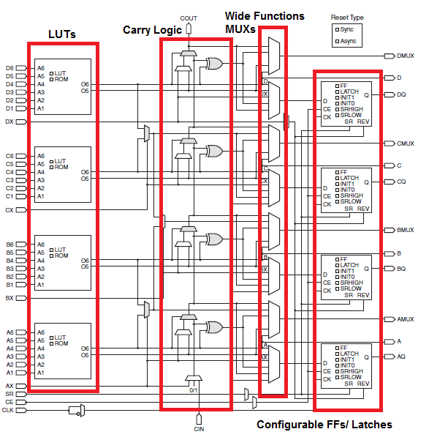
Configurable Logic Blocks
A CLB can contain several slices, which make up a single CLB. Xilinx Virtex-5 FPGAs (right) have two slices: SLICEL (logic) and SLICEM (memory).
In addition to the basic CLB architecture, the Virtex-5 contains wide-function MUXs which can implement:
- 4:1 MUX using 1 LUT
8:1 MUX using 2 LUTs
16:1 MUX using 4 LUTs

Slide 45
Implements any Two 4-input Functions
4-input function
3-input function;
registered

Slide 46
Implement Some Larger Functions
e.g. 9-input parity

Slide 47
Implements any 5-input Function
5-input function

Slide 48
Two Slices: Any 6-input Function
from other slice
6-input function

Slide 49
Fast Carry Chain: Add two bits per slice
Carry(a,b,cin)
Sum(a,b,cin)
a
b
cin

Slide 50
Lookup Tables used as memory (16 x 2)
[ Distributed Memory ]

Slide 51
Lookup Tables used as memory (32 x 1)

Slide 52
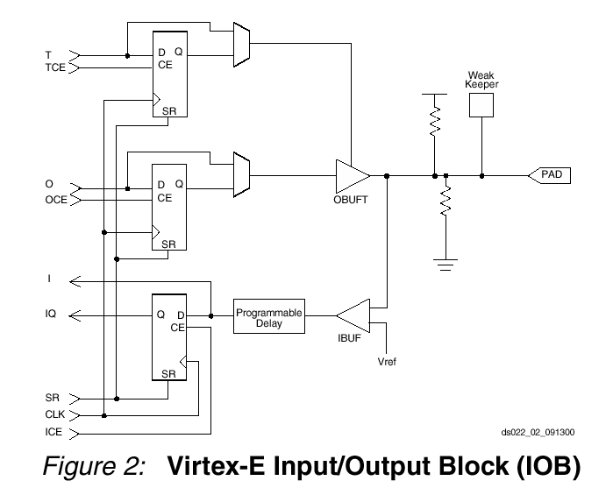
Virtex IOB

Slide 53
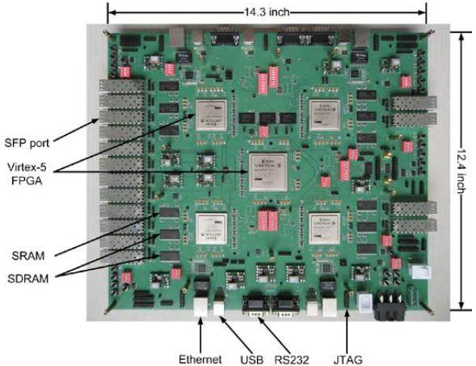
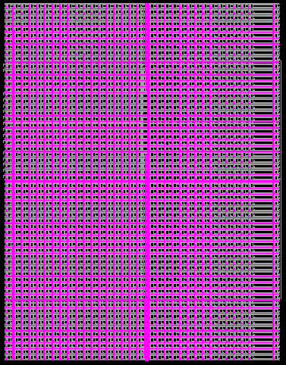
Xilinx Virtex-5 FPGAs
Multi-FPGA-based emulation framework for NoC design and verification (UNLV Networking and System Integration Laboratory)

Slide 54
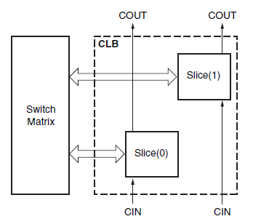
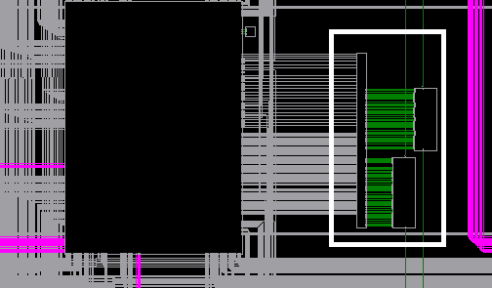
Virtex-5 CLB
A single CLB in Virtex-5 consists of two slices: SLICEL (logic) and SLICEM (memory). Each CLB is connected to a switch matrix which can access to a general routing (global) matrix.
Every slice contains four LUTS, wide function MUXs, carry logic, and configurable memory elements. SLICEM support storing data using distributed RAM and data shifting with 32-bit shift registers

Slide 55
SLICEL

Slide 56
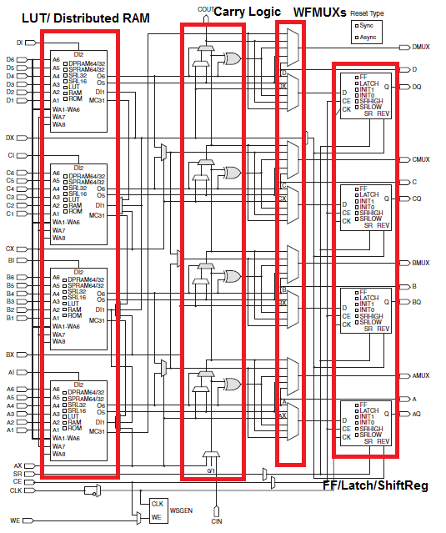
SLICEM

Slide 57
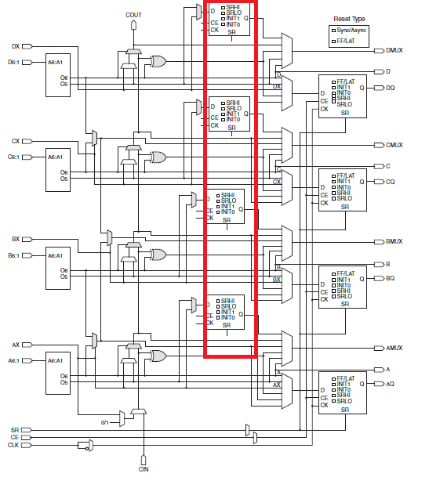
FPGA Design Comparison Virtex-5, Virtex-6, and spartan 6
Virtex-6 CLB have the same setup as Virtex-5 (SLICEL & SLICEM)
Virtex-6 devices add four additional storage elements which can only be configured as edge-triggered D-FFs. The D inputs are driven by the output of the LUTs or bypass slice inputs AX-DX

Slide 60
FPGA structure

Slide 61
Simplified CLB Structure

Slide 62
Example: 4-input AND gate
A | B | C | D | O
0 | 0 | 0 | 0 | 0
0 | 0 | 0 | 1 | 0
0 | 0 | 1 | 0 | 0
0 | 0 | 1 | 1 | 0
0 | 1 | 0 | 0 | 0
0 | 1 | 0 | 1 | 0
0 | 1 | 1 | 0 | 0
0 | 1 | 1 | 1 | 0
1 | 0 | 0 | 0 | 0
1 | 0 | 0 | 1 | 0
1 | 0 | 1 | 0 | 0
1 | 0 | 1 | 1 | 0
1 | 1 | 0 | 0 | 0
1 | 1 | 0 | 1 | 0
1 | 1 | 1 | 0 | 0
1 | 1 | 1 | 1 | 1

Slide 63
Example 2: Find the configuration bits for the following circuit
A0 | A1 | S
0 | 0 | 0
0 | 0 | 1
0 | 1 | 0
0 | 1 | 1
1 | 0 | 0
1 | 0 | 1
1 | 1 | 0
1 | 1 | 1

Slide 64
Interconnection Network

Slide 65
Example 3
Determine the configuration bits for the following circuit implementation in a 2x2 FPGA, with I/O constraints as shown in the following figure. Assume 2-input LUTs in each CLB.

Slide 66
CLBs required

Slide 67
Placement: Select CLBs

Slide 68
Routing: Select path

Slide 69
Configuration Bitstream
The configuration bitstream must include ALL CLBs and SBs, even unused ones
CLB0: 00011
CLB1: 01100
CLB2: XXXXX
CLB3: ?????
SB0: 000000
SB1: 000010
SB2: 000000
SB3: 000000
SB4: 000001

Slide 70
Realistic FPGA CLB: Xilinx

Slide 71
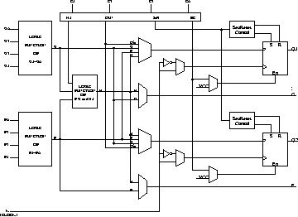
XC 4000
3 LUTs and 2 Flip-flops in a two stage arrangement
2 Outputs: Can be registered or combinational
External signals can also be registered
More of internal signals are available for connections
Can implement any two independent functions of four variables or any single function of five variables
XC4000 CLB

Slide 72
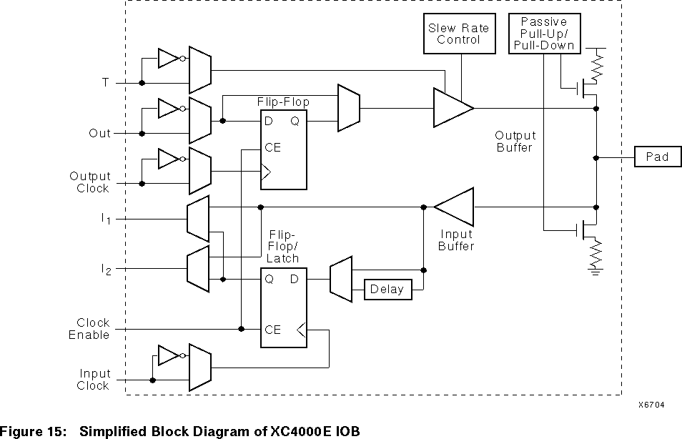
Xilinx FPGAs (IOB detail)

Slide 73
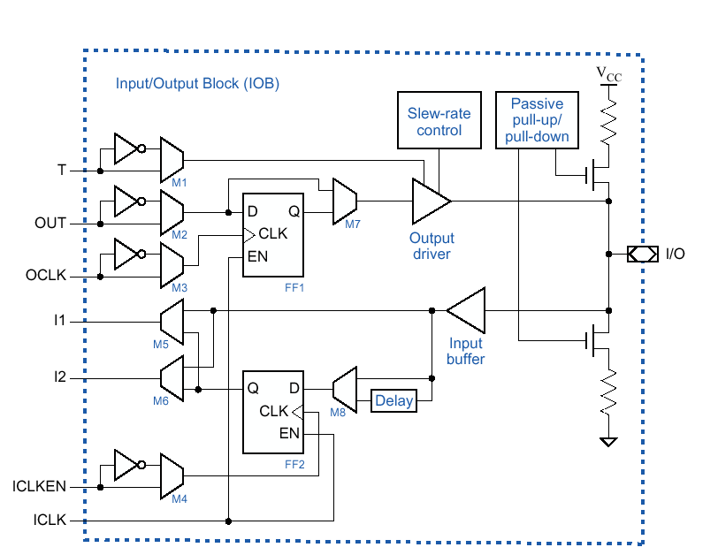
XC4000E I/O Block
Lect #14
Rissacher EE365

Slide 84
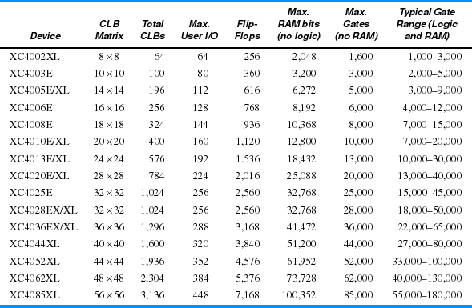
Xilinx 4000-series FPGAs
Lect #14
Rissacher EE365

Slide 85
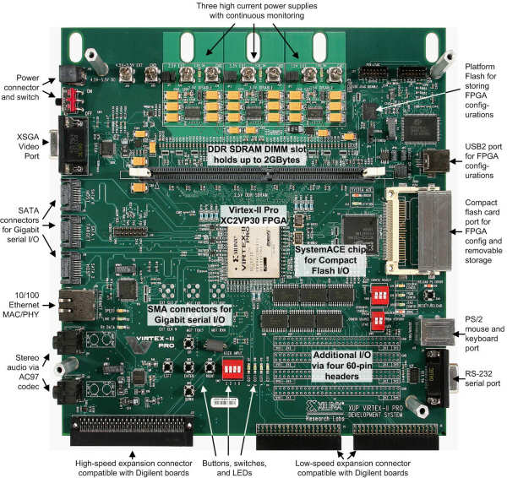
Xilinx Virtex-II Pro Development System
Notes:
Has 2 Physical Power PC Cores

Slide 86
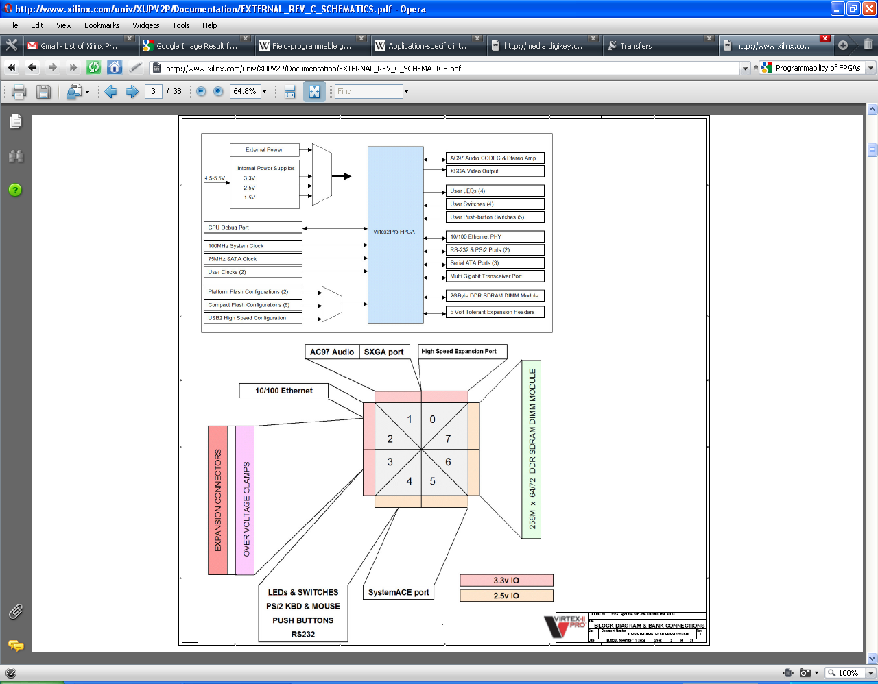
Xilinx Virtex-II Pro Development System Logic and FPGA Interaction
Notes:
Top: Block Diagram of the Virtex-II System
LEFT Side: Ways to configure the FPGA, Power the FPGA, Manage Clocking of the FPGA
RIGHT Side: Components/Peripherals and Outputs that can be utilized by the FPGA
Bottom: I/O pad connections to the Peripheral Devices

Slide 87
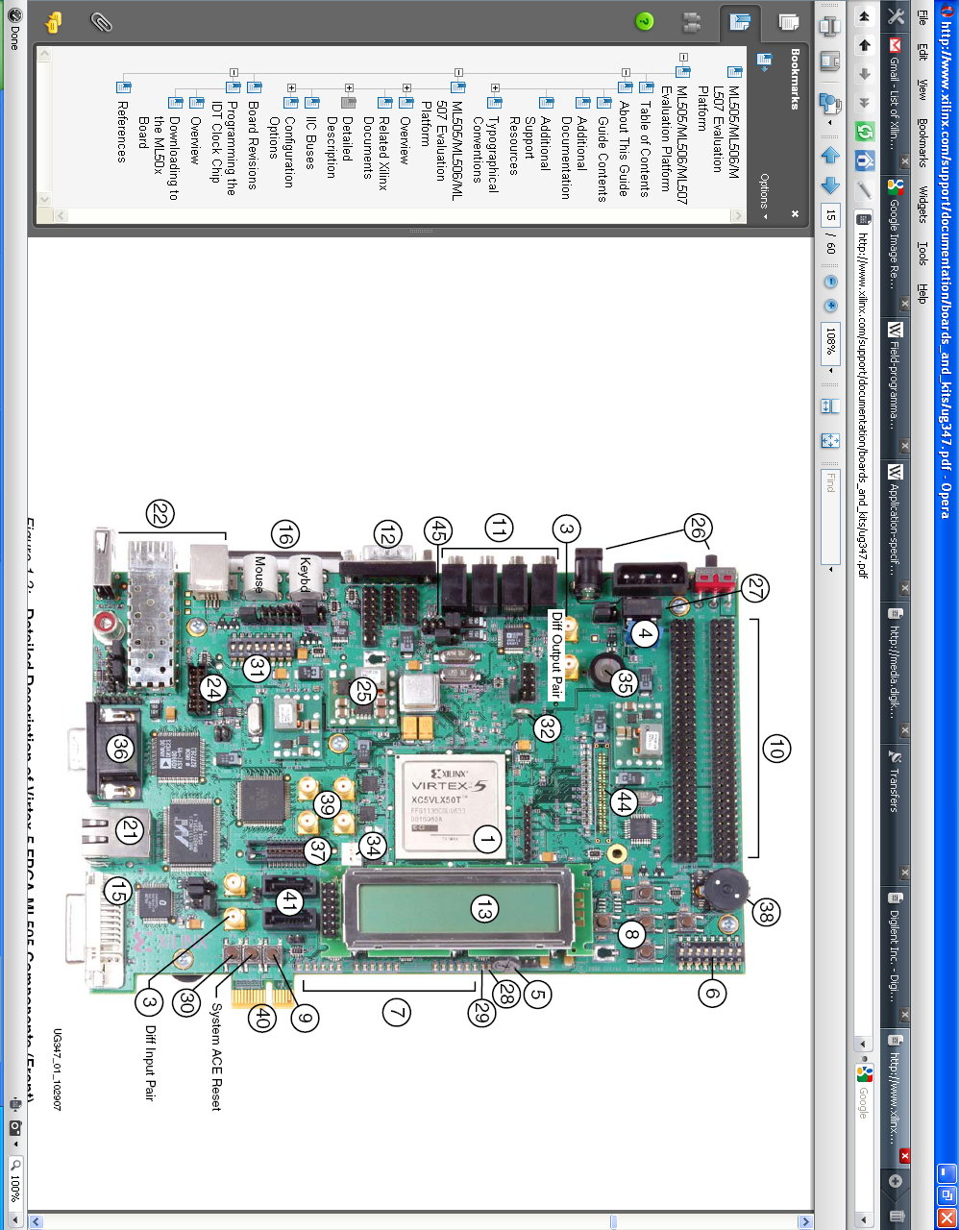
Xilinx Virtex 5 Development System (Front)
Notes:
Unlike the Virtex 2 the Virtex 5 uses a MicroBlaze processor; it is entirely software-based. Designed for Xilinx FPGAs from Xilinx. As a soft-core processor, MicroBlaze is implemented entirely in the general-purpose memory and logic fabric of Xilinx FPGAs

Slide 88
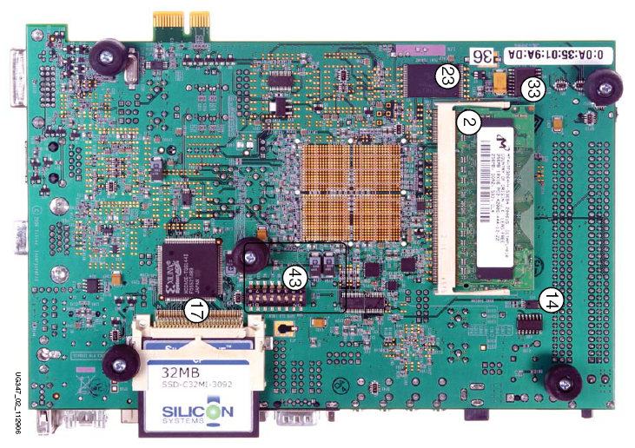
Xilinx Virtex 5 Development System (Back)

Slide 89
Xilinx Spartan-3E Starter Kit
FPGA
buttons
LEDs
switches

Slide 90
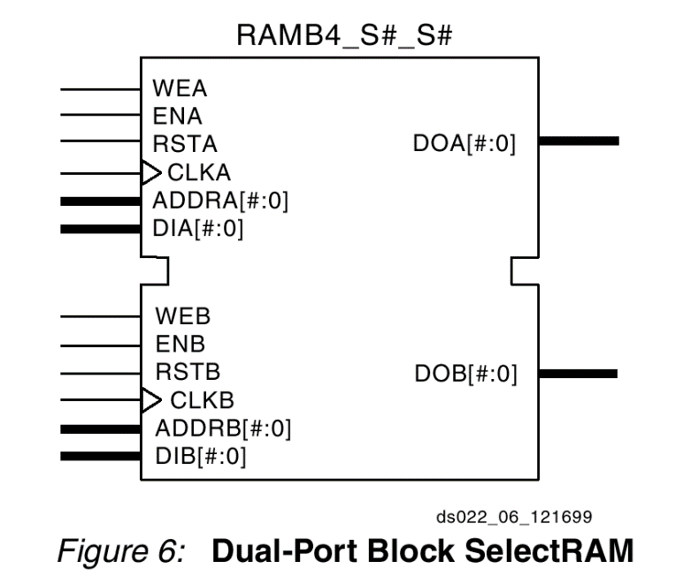
Virtex 5 Development System Components (FPGA)
In Comparison to the Virtex 2
Configurable Logic Blocks
Array (Row*Column): 80*46
Virtex 2 Slices: 13,969
Max Distributed RAM (Kb): 428
Block RAM Blocks
Max (Kb): 2,448
Configurable Logic Blocks
Array (Row*Column): 160*54
Virtex 5 Slices: 17,280
Max Distributed RAM (Kb): 1,120
Block RAM Blocks
18Kb: 296
36Kb: 148
Max (Kb): 5,328
DSP48E Slices: 64
CMTs: 6
PowerPC Processor Blocks: 0
Notes:
1. Virtex-5 FPGA slices are organized differently from previous generations. Each Virtex-5 FPGA slice contains four LUTs and four flip-flops (previously it was two LUTs and two flip-flops.)
2. Each DSP48E slice contains a 25 x 18 multiplier, an adder, and an accumulator.
3. Block RAMs are fundamentally 36 Kbits in size. Each block can also be used as two independent 18-Kbit blocks.
4. Each Clock Management Tile (CMT) contains two DCMs and one PLL.
5. This table lists separate Ethernet MACs per device.
6. RocketIO GTP transceivers are designed to run from 100 Mb/s to 3.75 Gb/s. RocketIO GTX transceivers are designed to run from 150 Mb/s to
6.5 Gb/s.
7. This number does not include RocketIO transceivers.
8. Includes configuration Bank 0.
DCM: Digital Clock Manager
A phase-locked loop or phase lock loop (PLL) is a control system that generates a signal that has a fixed relation to the phase of a "reference" signal. A phase-locked loop circuit responds to both the frequency and the phase of the input signals, automatically raising or lowering the frequency of a controlled oscillator until it is matched to the reference in both frequency and phase. A phase-locked loop is an example of a control system using negative feedback.
In simpler terms, a PLL compares the frequencies of two signals and produces an error signal which is proportional to the difference between the input frequencies. The error signal is then low-pass filtered and used to drive a voltage-controlled oscillator (VCO) which creates an output frequency. The output frequency is fed through a frequency divider back to the input of the system, producing a negative feedback loop. If the output frequency drifts, the error signal will increase, driving the frequency in the opposite direction so as to reduce the error. Thus the output is locked to the frequency at the other input. This input is called the reference and is often derived from a crystal oscillator, which is very stable in frequency.

Slide 91
Programming Environment
(ISE Simulator)
ISE Foundation (Project Navigator) allows for the start of the FPGA design process
Runs in background to maintain operation and flow of design by managing the chain of tools involved including but not limited to: Embedded Development Kit (EDK), ChipScope Pro and AccelDSP
EDK consists of XPS as mentioned before this can be run independently to begin a project however use of the project navigator provides for a more organized design process of an embedded system

Slide 92
Recommended Tool Set
Design Entry
  HDL Designer / Active HDL / Text Pad
Simulation
  ModelSim / Active HDL / NC Sim
Synthesis
  XST / Amplify / Synplify
Place & Route
  ISE

Slide 93
FPGA Comparison Table
Features | Artix-7 | Kintex-7 | Virtex-7 | Spartan-6 | Virtex-6
Logic Cells | 352,000 | 480,000 | 2,000,000 | 150,000 | 760,000
BlockRAM | 19Mb | 34Mb | 68Mb | 4.8Mb | 38Mb
DSP Slices | 1,040 | 1,920 | 3,600 | 180 | 2,016
DSP Performance (symmetric FIR) | 1,248GMACS | 2,845GMACS | 5,335GMACS | 140GMACS | 2,419GMACS
Transceiver Count | 16 | 32 | 96 | 8 | 72
Transceiver Speed | 6.6Gb/s | 12.5Gb/s | 28.05Gb/s | 3.2Gb/s | 11.18Gb/s
Total Transceiver Bandwidth (full duplex) | 211Gb/s | 800Gb/s | 2,784Gb/s | 50Gb/s | 536Gb/s
Memory Interface (DDR3) | 1,066Mb/s | 1,866Mb/s | 1,866Mb/s | 800Mb/s | 1,066Mb/s
PCI Express® Interface | Gen2x4 | Gen2x8 | Gen3x8 | Gen1x1 | Gen2x8
Agile Mixed Signal (AMS)/XADC | Yes | Yes | Yes |  | Yes
Configuration AES | Yes | Yes | Yes | Yes | Yes
I/O Pins | 600 | 500 | 1,200 | 576 | 1,200
I/O Voltage | 1.2V, 1.35V, 1.5V, 1.8V, 2.5V, 3.3V | 1.2V, 1.35V, 1.5V, 1.8V, 2.5V, 3.3V | 1.2V, 1.35V, 1.5V, 1.8V, 2.5V, 3.3V | 1.2V, 1.5V, 1.8V, 2.5V, 3.3V | 1.2V, 1.5V, 1.8V, 2.5V
EasyPath Cost Reduction Solution | - | Yes | Yes | - | Yes

